Slide 1
STEM
A strategic plan centering on recruiting, retaining, and graduating STEM Students

Slide 2
What is the STEM Mission?
Palo Alto College will be known as the #1 community college in the nation for preparing and placing high quality STEM graduates in employment and education opportunities.

Slide 3
Recruitment- STEM Summer Experience Program
Free two-week summer camp (Title V)
Targeted incoming college bound students
Exposed students to exciting, experiential learning in STEM fields.
Biology, Chemistry, and Engineering
Total of 22 students participated and completed!

Slide 4
Recruitment- STEM Summer Experience Program (Survey Responses)
The 22 participants were surveyed at the conclusion and all said they were “likely” or “very likely” to recommend this STEM Summer Experience program to other incoming students.
When asked at the beginning of the program, “How knowledgeable are you about STEM fields/programs?” on a scale of 1-5 with 1 being Not Knowledgeable and 5 being Very Knowledgeable, many students rated themselves Not Knowledgeable to Somewhat Knowledgeable. At the end of the two weeks, all students answered Knowledgeable to Very Knowledgeable.

Slide 5
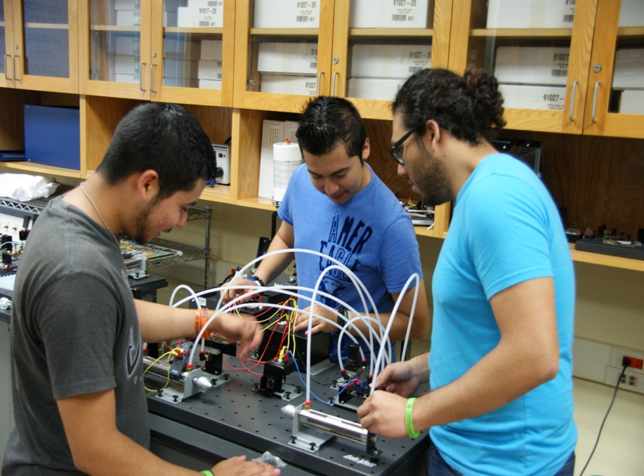
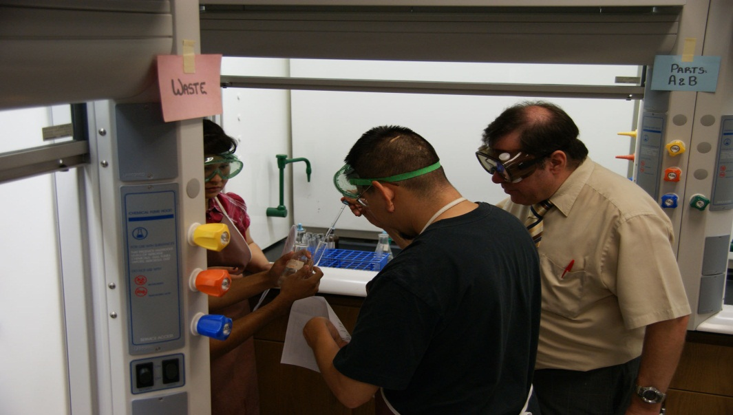
Recruitment- STEM Summer Experience Program (Quotes)
“Everything is hands-on and you get a live college experience.”Marcelino Najera, Southwest H.S.
“It was a good first step into college and there was zero pressure. All the teachers were helpful. It’s all just fun!”, Rocque Gutierrez, Frank Tejeda Academy.

Slide 6
Retention-TSTEM Scholarship Challenge
Texas Higher Education Coordinating Board awarded Alamo Colleges $895,000.00 for academic year 2012-13 and $1,000,000.00 for academic year 2013-14.
PAC’s portion $170,000.00, which assisted 68 students for the 2012-13 academic year in receiving a $2500.00 scholarship for the year
PAC’s portion $190,000.00 , will assist approximately 76 students for the 2013-14 academic year in receiving a $2500.00 scholarship for the year.

Slide 7
Retention-T STEM Scholarship Requirements
Be a declared major in a STEM (Science, Technology, Engineering and Mathematics) instructional program and specific Allied Health programs.
Submit a scholarship application at https://wwwsecure.alamo.edu/scholarship/application.aspx
Submit an official high school transcript to the T-STEM Liaison
Have a minimum GPA of 3.0 in high school Math and Science courses
Agree to complete 30 hours in 2012-2013 (Fall, Spring, Summer)
Complete 80% of coursework per semester
No financial aid restrictions
Men between the ages of 18 and 25 must be registered with the Selective Service System: https://www.sss.gov/RegVer/wfRegistration.aspx
Maintain a 2.0 or above to continue to receive funding

Slide 8
Retention-TSTEM Scholarship Challenge Program (Results 12-13)
PAC’s Student Success Results for the 68 T STEM Scholars:
Hours:
GPA:
Average Hours Completed for Fall and Spring:
Avg. Fall Attempted | Avg. Spring Attempted | Avg. Fall Completed | Avg. Spring Completed
13.25 | 13.04 | 12.64 | 11.32
Overall Fall GPA | Overall Spring GPA
3.36 | 3.28
Avg. Hours Completed for Fall and Spring
23.97

Slide 9
Graduation-Undergraduate Advising Center (STEM Advisors)
Title V-Project Care Grant has funded 5 dedicated Academic STEM Advisors to support:
Intrusive Academic Advising
Career Planning and Research
Transfer Opportunities
Support Undeclared Majors & Liberal Arts Majors to Explore STEM Careers and Degree Pathways
Encourage Degree Completion and Graduation in STEM Majors

Slide 10
Continued Academic Support
Louis Stokes Alliances for Minority Participation (LS-AMP) Grant-
$1.5 million awarded for the Alamo Colleges.
Dedicated support for Supplemental Instruction (SI), tutors, peer mentors, and student travel (in-state)
Student Stipends for research, and faculty/staff development
3 year grant cycle with PAC receiving a proportion of a yearly award ($500,000.00)

Slide 11
MAJOR GRANT ACTIVITIES
CAARE Project Activities
Faculty Development | Create the Problem-based Learning Clearinghouse professional development, instructional innovation and assessment.
Student Success | Implement the IACAPI Initiative that will: 1) Expand advising services for STEM students 2) Create the Student Success Coaching Program for STEM courses 3) Offer the Summer STEM Experience to entering Freshmen
Academic Enrichment | Expand the Science Exploration Laboratory and Interpretive Center to install: 1) A biofiltration system that will treat water run-off and discharge into the Center’s garden labs 2) An Acequias Feature and Demonstration Classroom to collect rainwater and convey the water throughout the Center
Fiscal Support | Create a STEM Endowed Scholarship Fund that Palo Alto College will match 100% by non federal funds ($500,000.00)

Slide 12
The Future
Title V Funding will run through 2016
Professional Development opportunities
Academic Support and Training
Continued Endowment
Advising Support
THECB funding is a two year award, may run through 2014
Summer programs will be replicated in Summer 2014
STEM Strategic Planning will continue..

Slide 13
Questions?
Abel R. Gonzales
Director, Title V STEM
Phone: 486-3176
Email: agonzales106@alamo.edu
Michael Ximenez
Director, Undergraduate Advising Center
Phone: 486-3181
Email: mximenez1@alamo.edu

